Slide 1
The Aim of Human Performance
‘Human Performance focuses on both reducing errors and managing defences to create immunity from significant events’
(UK Nuclear Human Performance Forum)

Slide 2
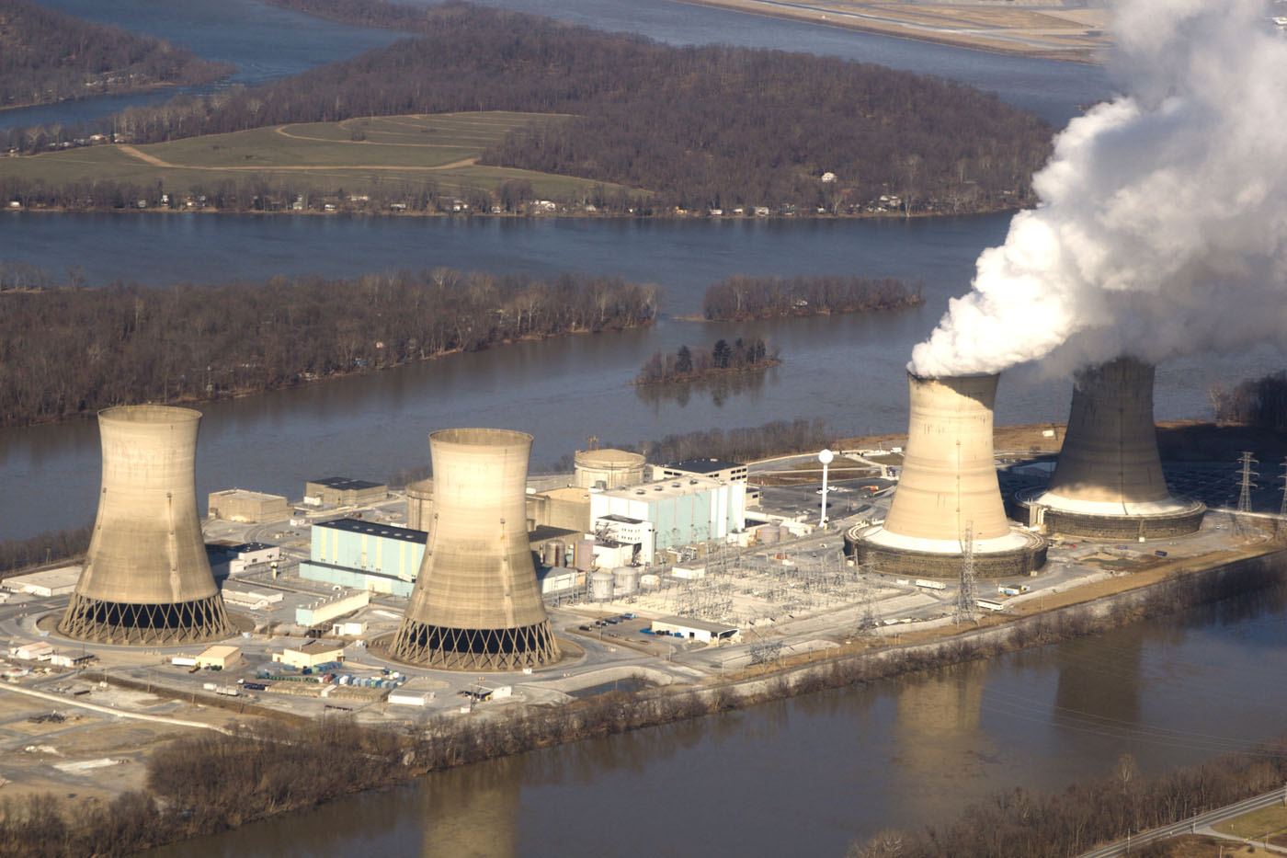


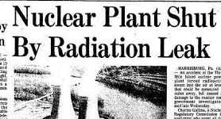





Three Mile Island
Power station

Slide 3
Human Performance Equation
Re + Md = ØE
Reducing active errors (Re) and Managing defences (Md) will lead to the absence of Events caused by human error (ØE).

Slide 4
Human Performance principles:
People are fallible – even the best make mistakes
Error likely situations are - predictable, manageable and preventable
Behaviors are influenced by - organisational processes and values
People achieve high levels of performance - largely through encouragement and reinforcement
Events can be avoided by - understanding the reasons mistakes happen and applying the lessons learned

